Slide 1

INTRODUCTION TO OOP
Objective:
Know the difference between functional programming
and OOP
Know basic terminology in OOP
Know the importance of OOP
Know four design principles of OOP
Know OOP programming languages
‹#›
Notes:
‹#›

Slide 2

STRUCTURED vs. OO PROGRAMMING
STRUCTURED PROGRAMMING:
MAIN PROGRAM
GLOBAL DATA
FUNCTION 1
FUNCTION 2
FUNCTION 3
FUNCTION 4
FUNCTION 5
‹#›

Slide 3
Structured Programming
Using function
Function & program is divided into modules
Every module has its own data and function which can be called by other modules.
‹#›

Slide 4

OBJECT ORIENTED PROGRAMMING
Object 1
Object 2
Data
Data
Function
Function
Object 3
Data
Function
‹#›

Slide 5
OBJECT ORIENTED PROGRAMMING
Objects have both data and methods
Objects of the same class have the same data elements and methods
Objects send and receive messages to invoke actions
Key idea in object-oriented:
The real world can be accurately described as a collection of objects that interact.
‹#›

Slide 6
Basic terminology
object
- usually a person, place or thing (a noun)
method
- an action performed by an object (a verb)
attribute
- description of objects in a class
class
- a category of similar objects (such as automobiles)
- does not hold any values of the object’s attributes
‹#›

Slide 7

Example for attributes and methods
Attributes:
manufacturer’s name
model name
year made
color
number of doors
size of engine
etc.
Methods:
Define data items (specify manufacturer’s name, model, year, etc.)
Change a data item (color, engine, etc.)
Display data items
Calculate cost
etc.
‹#›

Slide 8

Why OOP?
Save development time (and cost) by reusing code
once an object class is created it can be used in other applications
Easier debugging
classes can be tested independently
reused objects have already been tested
‹#›

Slide 9

Design Principles of OOP
Four main design principles of Object-Oriented Programming(OOP):
Encapsulation
Abstraction
Polymorphism
Inheritance
‹#›

Slide 10

Encapsulation
Also known as data hiding
Only object’s methods can modify information in the object.
Analogy:
ATM machine can only update accounts of one person or object only.
‹#›

Slide 11
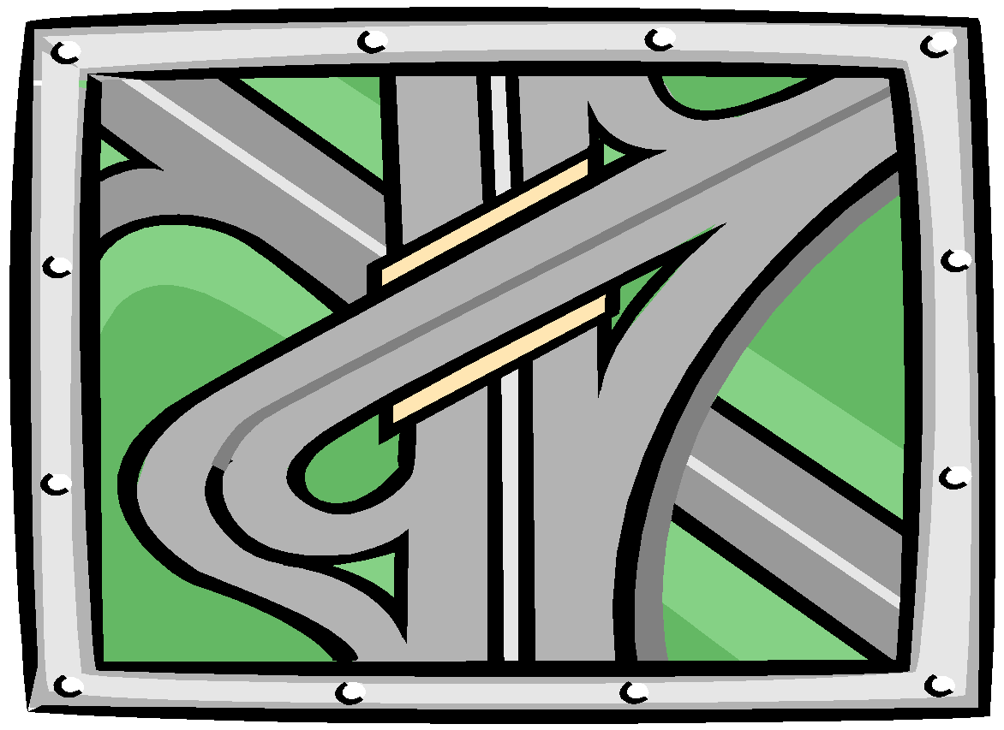
Abstraction
Focus only on the important facts about the problem at hand
to design, produce, and describe so that it can be easily used without knowing the details of how it works.
Analogy:
When you drive a car, you don’t have to know how the gasoline and air are mixed and ignited.
Instead you only have to know how to use the controls.
Draw map
‹#›

Slide 12


Polymorphism
the same word or phrase can mean different things in different contexts
Analogy:
In English, bank can mean side of a river or a place to put money
move -
‹#›

Slide 13
Function Overloading
The operation of one function depends on the argument passed to it.
Example: Fly(), Fly(low), Fly(150)
‹#›

Slide 14
Inheritance
Inheritance—a way of organizing classes
Term comes from inheritance of traits like eye color, hair color, and so on.
Classes with properties in common can be grouped so that their common properties are only defined once.
Superclass – inherit its attributes & methods to the subclass(es).
Subclass – can inherit all its superclass attributes & methods besides having its own unique attributes & methods.
‹#›

Slide 15
An Inheritance Hierarchy
Superclass
Vehicle
Subclasses
Automobile
Motorcycle
Bus
Sedan
Sports Car
Luxury Bus
School Bus
What properties does each vehicle inherit from the types of vehicles above it in the diagram?
‹#›

Slide 16

Object-Oriented Programming Languages
∙ Pure OO Languages
Smalltalk, Eiffel, Actor, Java
∙ Hybrid OO Languages
C++, Objective-C, Object-Pascal
‹#›

